Slide 1

Discrete Probability Distributions
Chapter 6
McGraw-Hill/Irwin
Copyright © 2012 by The McGraw-Hill Companies, Inc. All rights reserved.

Slide 2
Learning Objectives
LO1 Identify the characteristics of a probability distribution.
LO2 Distinguish between discrete and continuous random
variable.
LO3 Compute the mean of a probability distribution.
LO4 Compute the variance and standard deviation of a
probability distribution.
LO5 Describe and compute probabilities for a binomial
distribution.
6-<number>

Slide 3

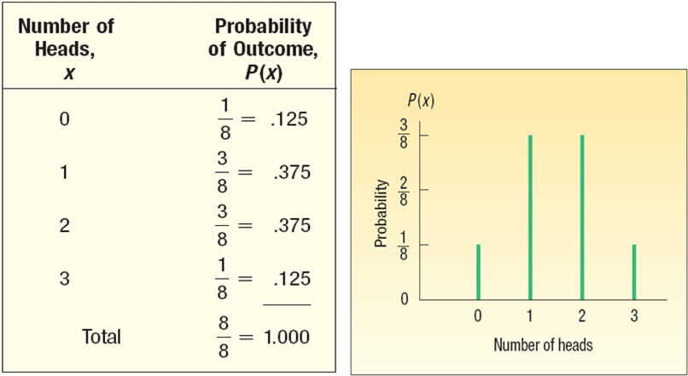
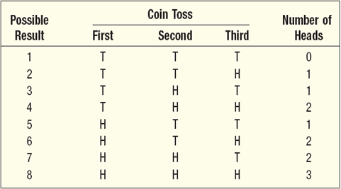
What is a Probability Distribution?
LO1 Identify the characteristics of a probability distribution.
PROBABILITY DISTRIBUTION A listing of all the outcomes of an experiment and the probability associated with each outcome.
CHARACTERISTICS OF A PROBABILITY DISTRIBUTION
The probability of a particular outcome is between 0 and 1 inclusive.
The outcomes are mutually exclusive events.
The list is exhaustive. So the sum of the probabilities of the various events is equal to 1.
Experiment:
Toss a coin three times. Observe the number of heads. The possible results are: Zero heads, One head, Two heads, and Three heads.
What is the probability distribution for the number of heads?
6-<number>

Slide 4

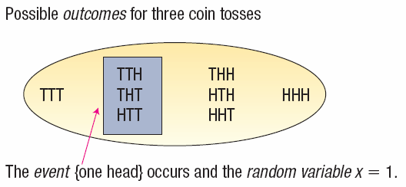
Random Variables
LO1
RANDOM VARIABLE A quantity resulting from an experiment that, by chance, can assume different values.
CONTINUOUS RANDOM VARIABLE can assume an infinite number of values within a given range. It is usually the result of some type of measurement
DISCRETE RANDOM VARIABLE A random variable that can assume only certain clearly separated values. It is usually the result of counting something.
EXAMPLES
The number of students in a class.
The number of children in a family.
The number of cars entering a carwash in a hour.
Number of home mortgages approved by Coastal Federal Bank last week.
EXAMPLES
The length of each song on the latest Tim McGraw album.
The weight of each student in this class.
The temperature outside as you are reading this book.
The amount of money earned by each of the more than 750 players currently on Major League Baseball team rosters.
6-<number>

Slide 5

The Mean and Variance of a Discrete
Probability Distribution
LO3 and LO4 Compute the mean, standard deviation and variance of a probability distribution.
MEAN
The mean is a typical value used to represent the central location of a probability distribution.
The mean of a probability distribution is also referred to as its expected value.
VARIANCE AND STANDARD DEVIATION
Measures the amount of spread in a distribution
The computational steps are:
  1. Subtract the mean from each value, and square this difference.
  2. Multiply each squared difference by its probability.
  3. Sum the resulting products to arrive at the variance.
  The standard deviation is found by taking the positive square root of the variance.
6-<number>

Slide 6


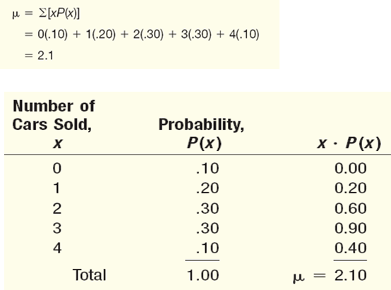
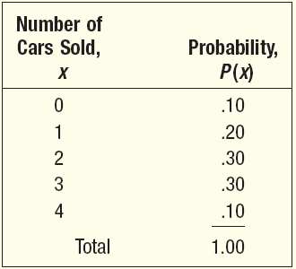

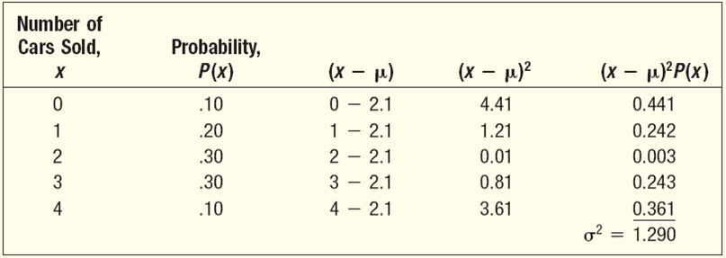

Mean, Variance, and Standard
Deviation of a Probability Distribution - Example
LO3, LO4
John Ragsdale sells new cars for Pelican Ford. John usually sells the largest number of cars on Saturday. He has developed the following probability distribution for the number of cars he expects to sell on a particular Saturday.
MEAN
VARIANCE
STANDARD
DEVIATION
6-<number>

Slide 7

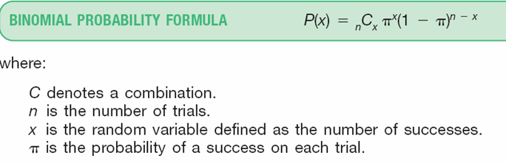
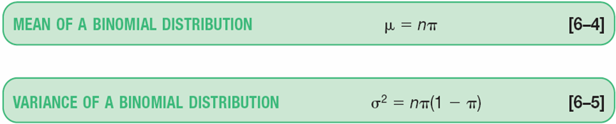
Binomial Probability Distribution
LO5 Describe and compute probabilities for a binomial distribution.
A Widely occurring discrete probability distribution
Characteristics of a Binomial Probability Distribution
There are only two possible outcomes on a particular trial of an experiment.
The outcomes are mutually exclusive,
The random variable is the result of counts.
Each trial is independent of any other trial
6-<number>

Slide 8

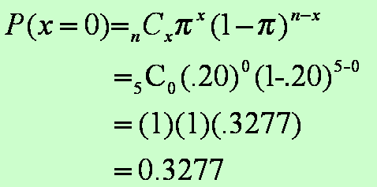
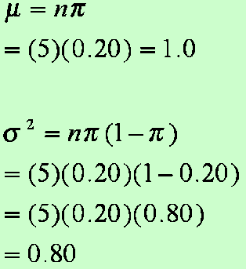
Binomial Probability Distribution
LO5
EXAMPLE
There are five flights daily from Pittsburgh via US Airways into the Bradford, Pennsylvania, Regional Airport. Suppose the probability that any flight arrives late is .20.
What is the probability that none of the flights are late today?
What is the average number of late flights? What is the variance of the number of late flights?
6-<number>

Slide 9
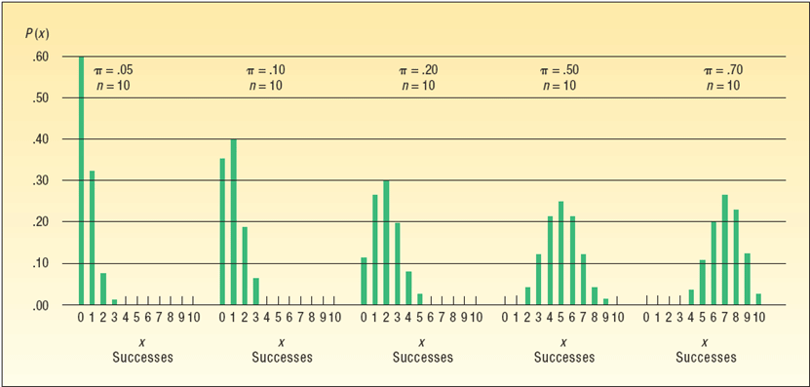
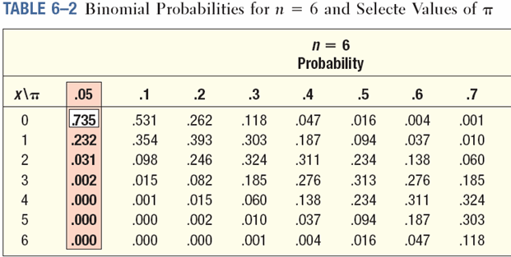
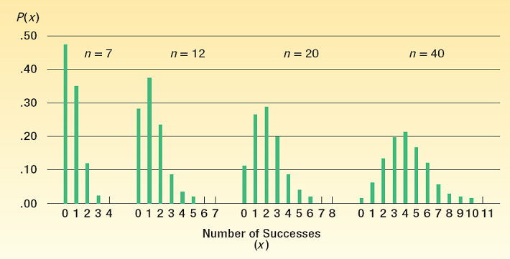
Binomial Distribution - Example
LO5
Binomial – Shapes for Varying π (n constant)
EXAMPLE
Five percent of the worm gears produced by an automatic, high-speed Carter-Bell milling machine are defective.
What is the probability that out of six gears selected at random none will be defective? Exactly one? Exactly two? Exactly three? Exactly four? Exactly five? Exactly six out of six?
Binomial – Shapes for Varying n (π constant)
6-<number>

Slide 10


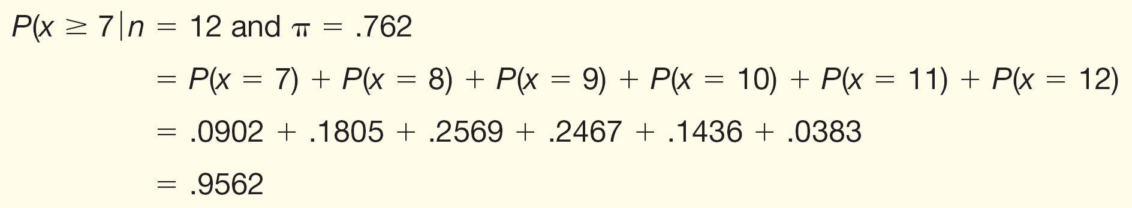
Cumulative Binomial Probability Distributions - Example
LO5
EXAMPLE
A study by the Illinois Department of Transportation concluded that 76.2 percent of front seat occupants used seat belts. A sample of 12 vehicles is selected.
What is the probability the front seat occupants in exactly 7 of the 12 vehicles are wearing seat belts?
What is the probability the front seat occupants in at least 7 of the 12 vehicles are wearing seat belts?
6-<number>

